Slide 1
AUTOMATIC TIMETABLE GENERATION
Team Details
G. SAI CHARAN REDDY (20EG105114)
G. SHIRISHA (20EG105115)
N. SAI PRATHIBHA (20EG105135)
P. NITISH GOUD (20EG105137)
Project Supervisor
Name: Dr. G. Prabhakar Raju
Designation: Assistant Professor

Slide 2
Introduction
The Automatic Timetable Generation project utilizes a genetic algorithm to automatically create optimized timetables for educational institutions. Users input information like the number of courses, classrooms, teachers, and available timeslots. The genetic algorithm generates a population of schedules, evaluates their fitness based on constraints and objectives, and iteratively refines solutions through selection, crossover, and mutation. The goal is to save time and effort for institutions, enhance timetable quality by considering multiple factors, and leverage genetic algorithms' ability to handle complex constraints in a large search space. The project aims to provide an effective and efficient solution for automated timetable generation.

Slide 3
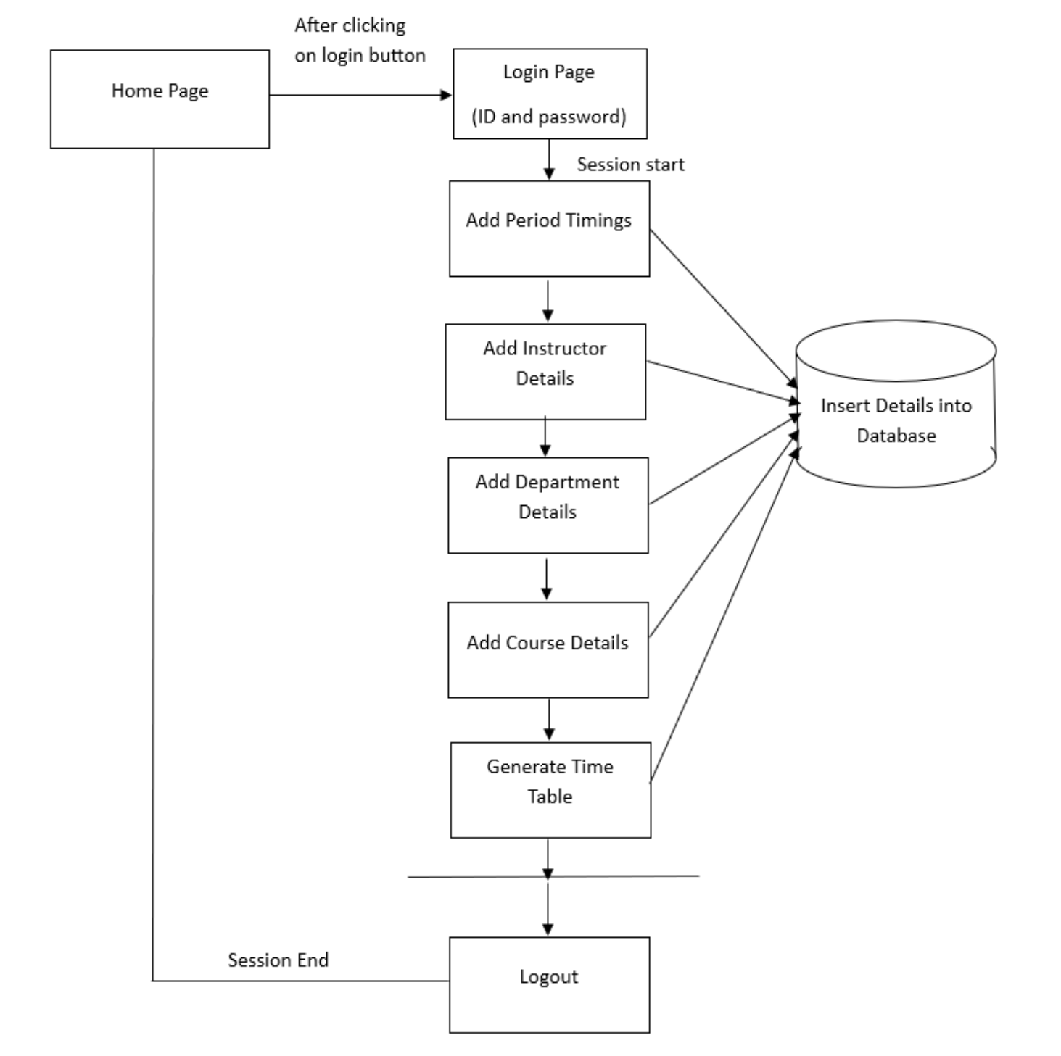
Problem Statement
Time table scheduling is a common challenge in academic institutes, typically requiring significant time and effort to manually organize. In the past, this task was done by individuals or small groups, leading to errors and complexities. Now, a program automates this process by taking inputs such as the number of periods, break slots, working days, teacher details, subjects, and their allocations to batches. It aims to fulfill user-defined constraints like resource availability and fairness using a genetic algorithm approach, refining solutions until a satisfactory timetable is achieved. This automated solution streamlines the complex scheduling process, saving time and reducing errors.

Slide 4
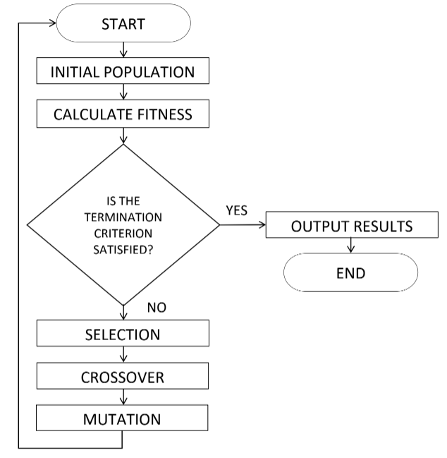
Proposed Method
The proposed system for Automatic timetable Generation utilizes genetic algorithms to efficiently generate optimal timetables for educational institutions. The genetic algorithm creates a population of possible timetables, employing crossover and mutation operations to produce new generations. A fitness function evaluates each timetable based on constraints and objectives, selecting the fittest for the next generation. It visualize, evaluate, and refine schedules, adjusting limits as needed, and compare multiple schedules to choose the best fit using conflicts. The system handles complex constraints, offers flexibility, and is designed for ease of use, saving time and effort for educational institutions.

Slide 5
Proposed Method
1)First of all an initial generation of chromosomes is created randomly and their fitness value is analysed.
New Generations are created after this. For each generation, it performs following basic operations:
First of all preserve few fittest chromosomes from the previous generation as it is. This is called Elitism and is necessary to preserve desired characteristics in the coming generations .
Randomly select a pair of chromosomes from the previous generation. Roulette wheel selection method has been used here in this project.
Perform crossover depending on the crossover rate which is pretty high usually. Here single point crossover has been used.
Perform mutation on the more fit chromosome so obtained depending on the mutation rate which is kept pretty small usually.
2)Now analyze the fitness of the new generation of chromosomes and order them according to fitness values.
3)Repeat creating new generations unless chromosomes of desired fitness value i.e. fitness=1, are obtained.

Slide 6
Experiment Environment
1.Development Language and Framework:
- Java 8
- Java Server Pages (JSP)
- Servlets
2.Database:
- MySQL database
3. Frontend Design:
- HTML 5
- Cascading Style Sheets (CSS)
- JavaScript
- Bootstrap
- Ajax
4. Web Server:
- Apache Tomcat-9 (locally hosted during development)
5.Experimentation Data:
- Sample input provided in the form for testing purposes during development.

Slide 7
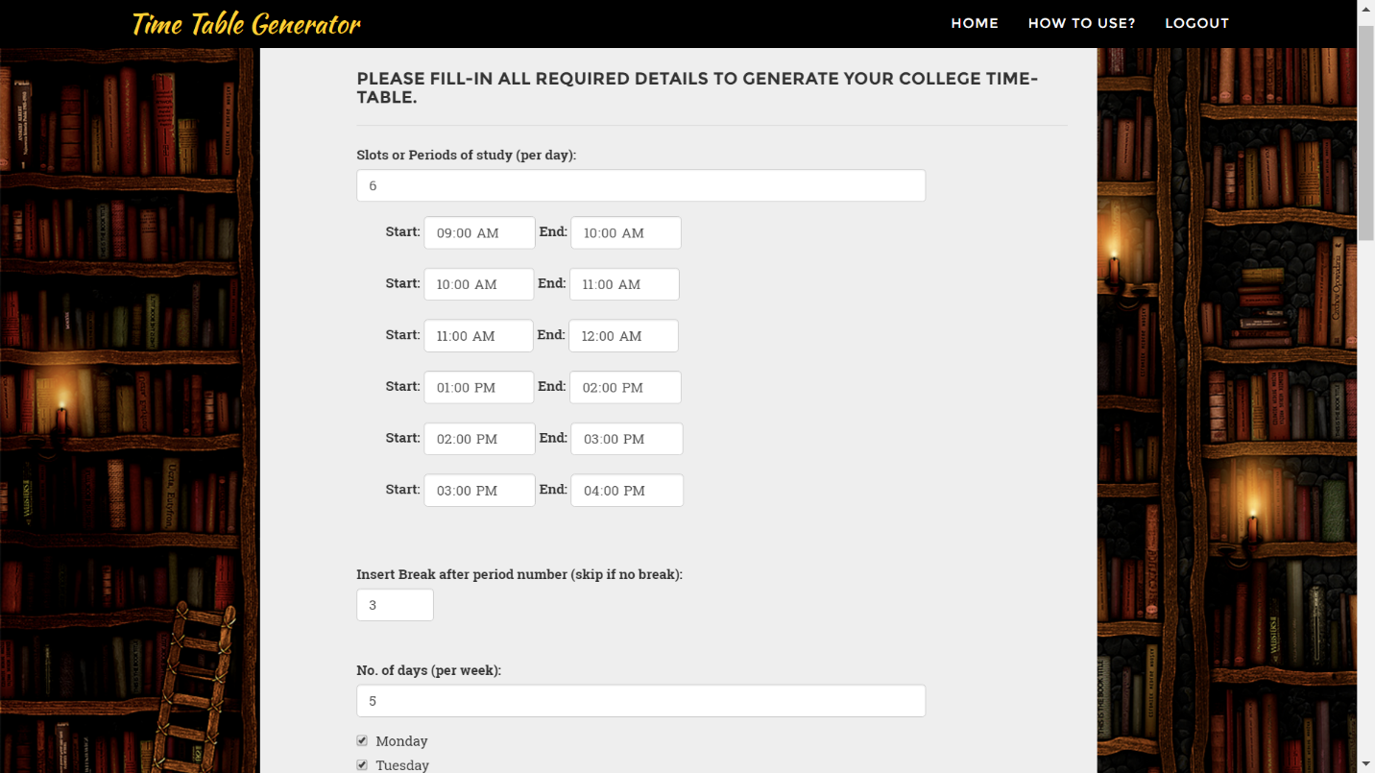
Experiment Screen shots

Slide 8
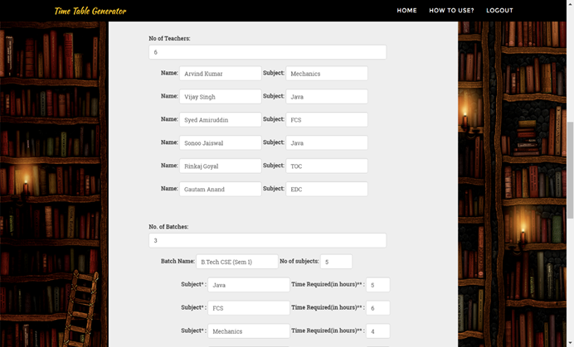
Experiment Screen shots

Slide 9
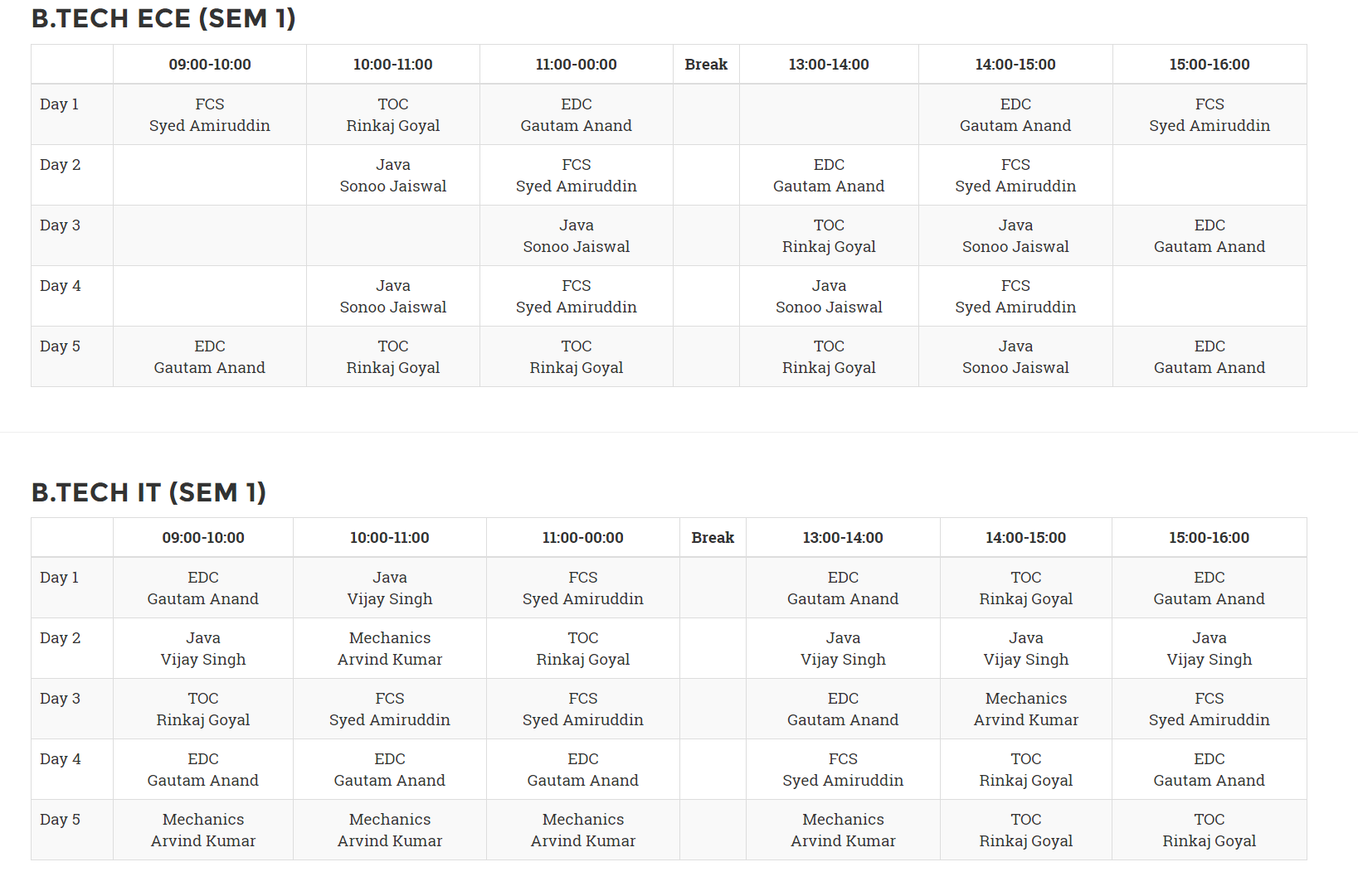
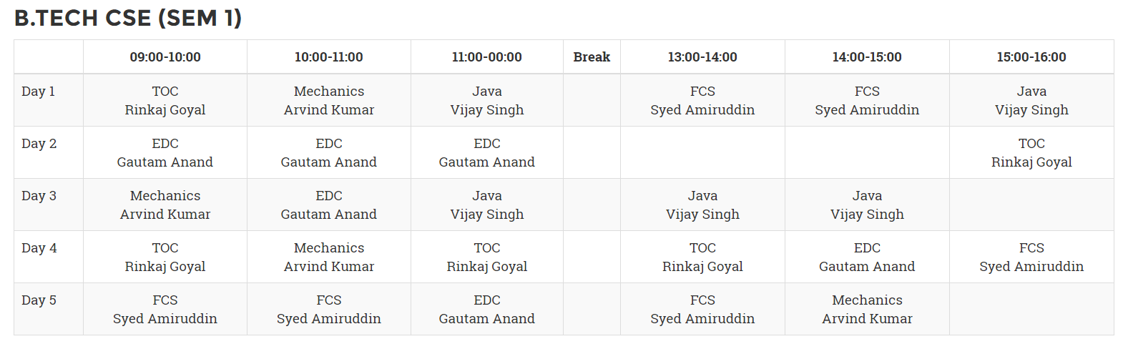
Experiment Results

Slide 10
Findings
To include equal load to faculty with the same subject and highlight the ability to add free periods, as well as the project's efficiency in generating timetables within seconds, here are additional points for the findings:
1.Equal Faculty Load: The project ensures fairness by distributing teaching loads equally among faculty members handling the same subject.
2. Inclusion of Free Periods:
The system intelligently incorporates free periods into the generated timetables, allowing for breaks and downtime for both students and faculty.
3. Efficient Generation Speed:
This rapid generation capability significantly reduces the time and resources required for timetable creation, enabling institutions to adapt quickly to changing schedules or demands.

Slide 11
Justification
the fitness function evaluates how well a solution meets the desired objectives. In the context of timetable generation, the fitness function assesses how closely the generated timetable adheres to certain criteria, such as minimizing conflicts, meeting resource constraints, and optimizing scheduling efficiency.
fitness=1-(point/((nostgrp-1.0)*hours*days)); point: measure of the conflicts present in the generated solution nostgrp: total number of batches being scheduled

Slide 12
THANK YOU

